Slide 1
Software Development Lifecycles

Slide 2
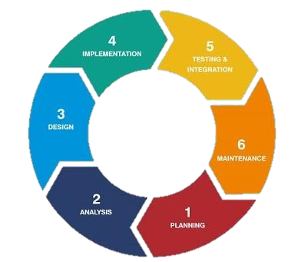
Software Development Lifecycle
THE SOFTWARE DEVELOPMENT CYCLE
A Software Development Lifecycle Model describes the types of activities performed at each stage in a software development project, and how the activities relate to one another logically and chronologically.

Slide 3
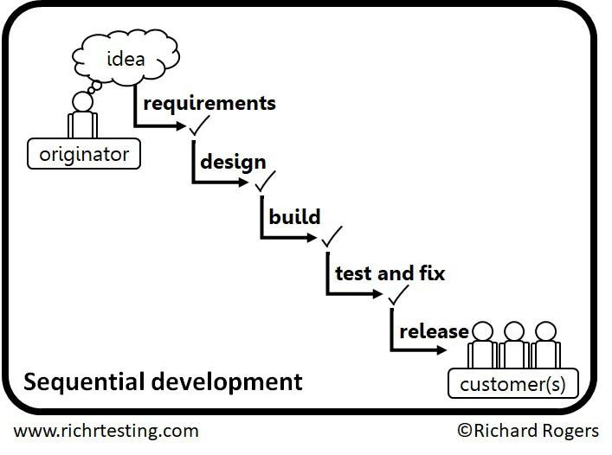
Software Development Lifecycle

Slide 4
SDLC
Iterative &
Incremental
Sequential

Slide 5
Sequential Software Development
A sequential development model describes the software development process as a linear, sequential flow of activities.
This means that any phase in the development process should begin when the previous phase is complete.
In theory, there is no overlap of phases, but in practice, it is beneficial to have early feedback from the following phase

Slide 6
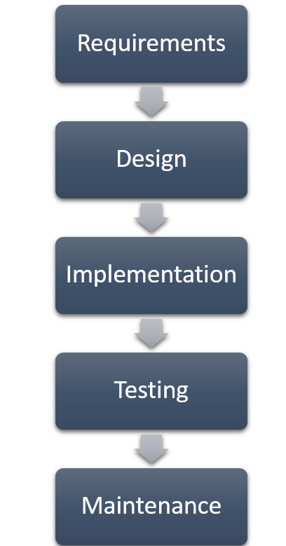
Waterfall Model
In the Waterfall model, the development activities are completed one after another.
In this model, test activities only occur after all other development activities have been completed

Slide 7
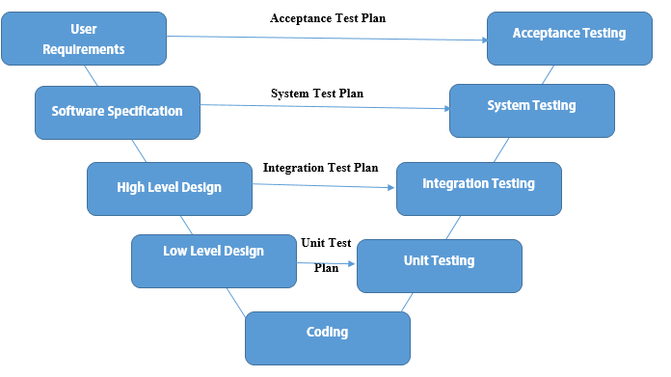
V-Model
Unlike the Waterfall model, the V-model integrates the test process throughout the development process, implementing the principle of early testing.

Slide 8
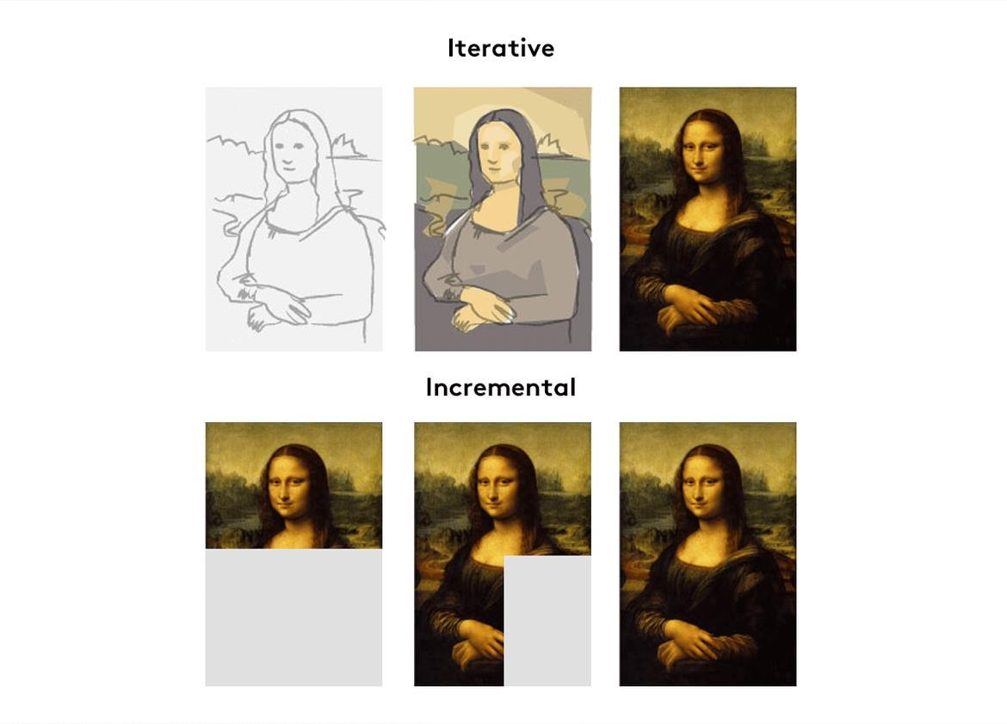
Iterative & Incremental Models

Slide 9
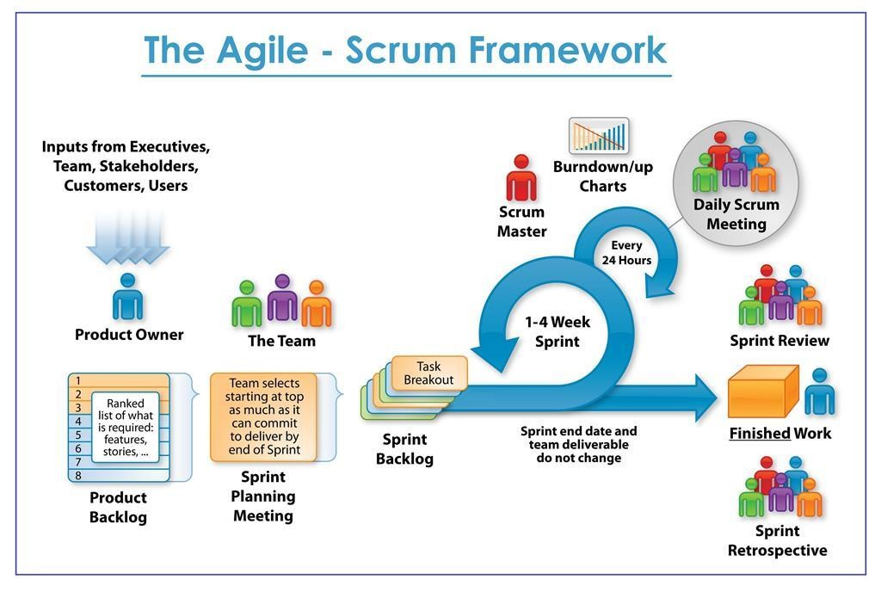
Scrum
Each iteration tends to be relatively short (e.g., hours, days, or a few weeks), and the feature increments
are correspondingly small, such as a few enhancements and/or two or three new features

Slide 10
What is Software Testing?

Slide 11

What is Software Testing?
Most people have had an experience with software that did not work as expected.
Software that does not work correctly can lead to many problems, including:
  loss of money, time, or business reputation
  Injury or death

Slide 12
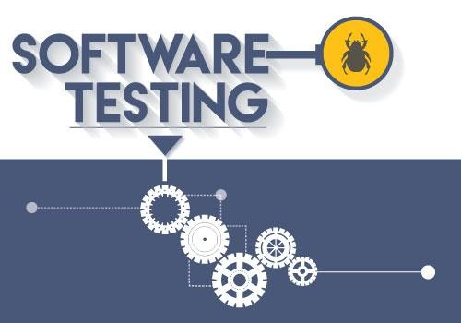
What is Software Testing?
Software testing is a way to:
  assess the quality of the software
  reduce the risk of software failure in operation

Slide 13
What is Software Testing?
Software Testing ≠ Test Execution
software testing is a process which includes many different activities
Execution is only one of these activities.

Slide 14
Software Testing
Dynamic
Testing
Static
Testing

Slide 15
Software Testing
Validation
Verification

Slide 16
Objectives of Software Testing
Providing
Work-product
Information to
Reduce Risk
Evaluation
Stakeholders
Requirements
Preventing
Compliance
Fulfillment
Defects
with Laws
Building
Finding Defects
Objectives
Confidence
may vary

Slide 17
Relationship between Testing & Debugging
Confirmation Testing
Testing
Debugging

Slide 18
Test Process

Slide 19
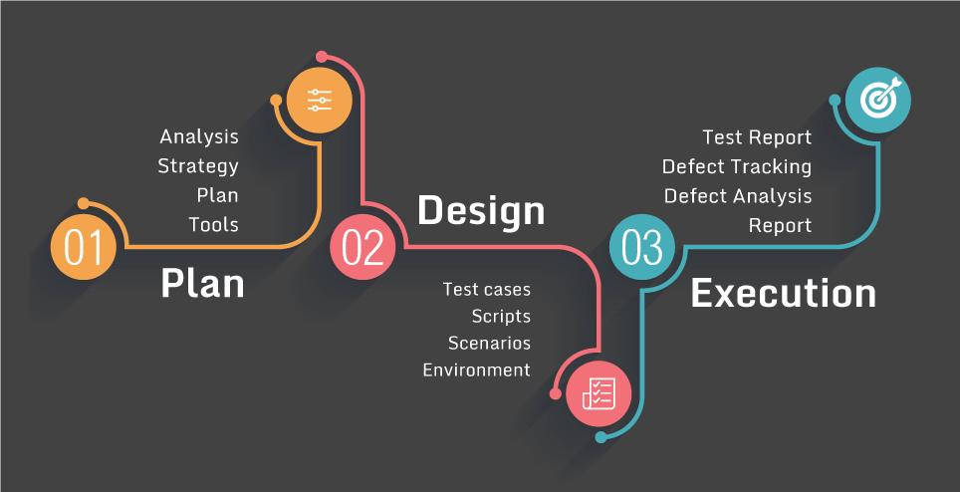
Test Process
There is no one universal software test process, but there are common sets of test activities without which testing will be less likely to achieve its established objectives

Slide 20
Test Process Activities
Test Planning
Test Monitoring & Control
Test Implementatio n
Test Execution
Test Completion
Test Analysis
Test Design

Slide 21
Test Levels

Slide 22
Test Levels
Acceptance
System
Integration Unit
Test levels are groups of test activities that are organized and managed together.
Each test level is an instance of the test process
Test levels are related to other activities within the software development lifecycle.

Slide 23
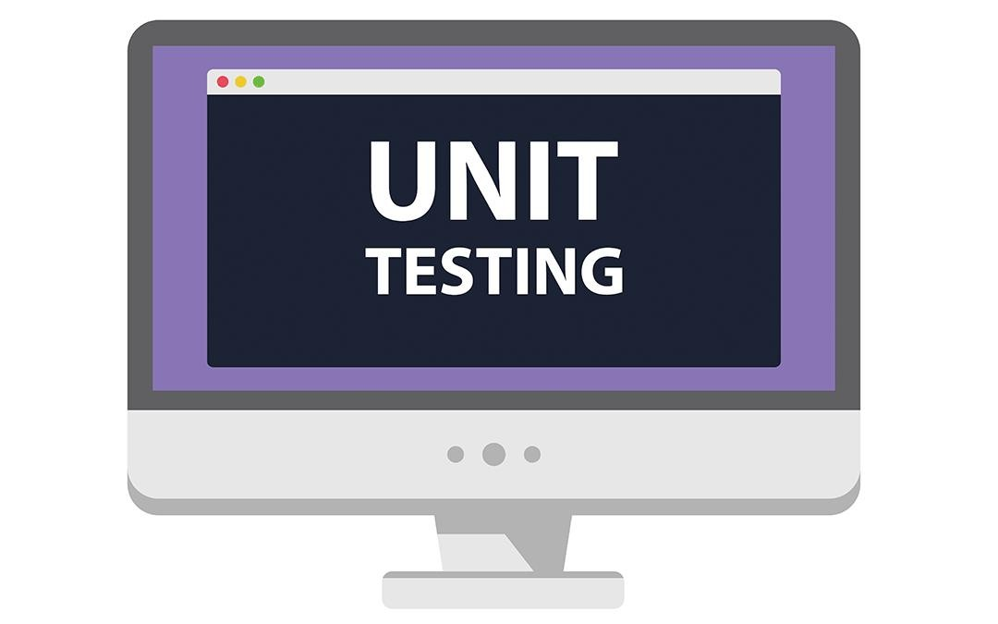
Component (Unit) Testing
Component testing (also known as unit or module testing) focuses on components that are separately testable

Slide 24

Integration Testing
Integration testing focuses on interactions between components or systems

Slide 25

Integration
Testing
Component
Integration
System
Integration

Slide 26
Integration Testing
Component integration testing is often the responsibility of developers.
System integration testing is generally the responsibility of testers.

Slide 27
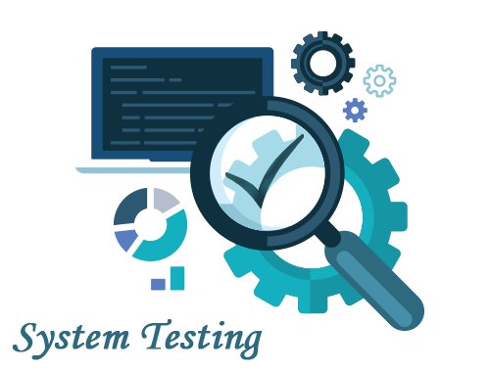
System Testing
System testing focuses on the behavior and capabilities of a whole system or product

Slide 28
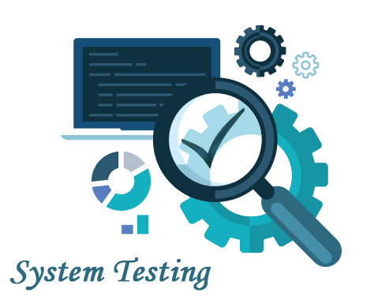
System Testing
System testing often produces information that is used
by stakeholders to make release decisions
The test environment should ideally correspond to the final target or production environment
System testing should focus on the overall, end-to-end
behavior of the system as a whole
Independent testers typically carry out system testing.

Slide 29
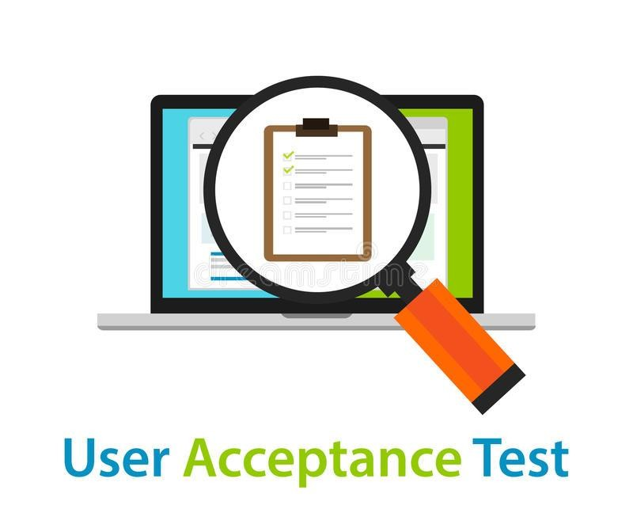
Acceptance Testing
Acceptance testing, like system testing, typically focuses on the behavior and capabilities of a whole system or product

Slide 30

Alpha & Beta Testing
Alpha Testing is done inside the organization
Beta Testing is done by users at their location

Slide 31
Testing Types

Slide 32
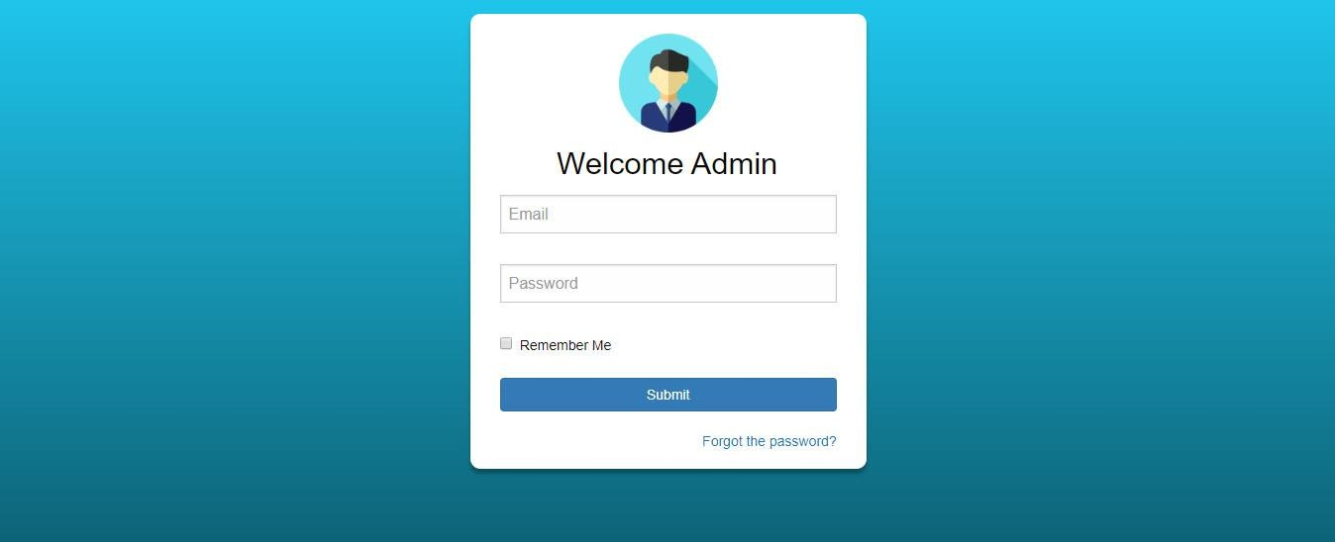
1-Functional Testing:
-Testing what the system does
-Usually answered with (Yes/No)

Slide 33
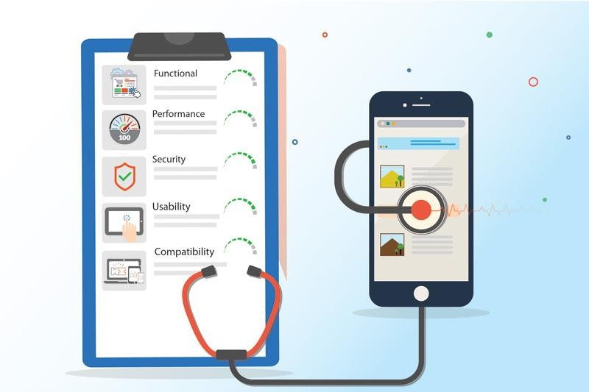
2-Non-functional Testing:
-Testing how the system performs
-Hard to answer with Yes/No
-Usually measured as a range

Slide 34
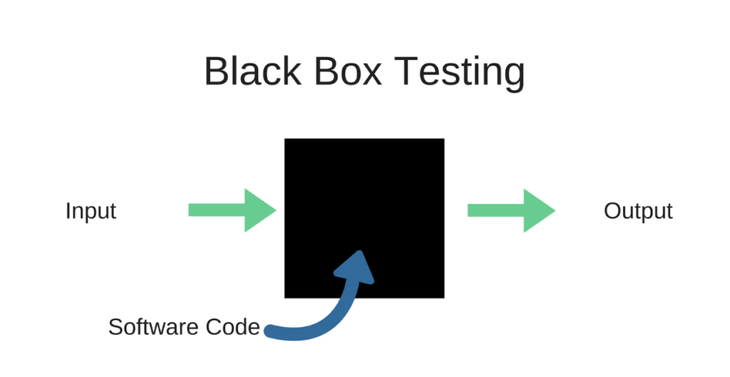
3-Black-Box Testing:
-Testing without knowing the internal structure of the system

Slide 35
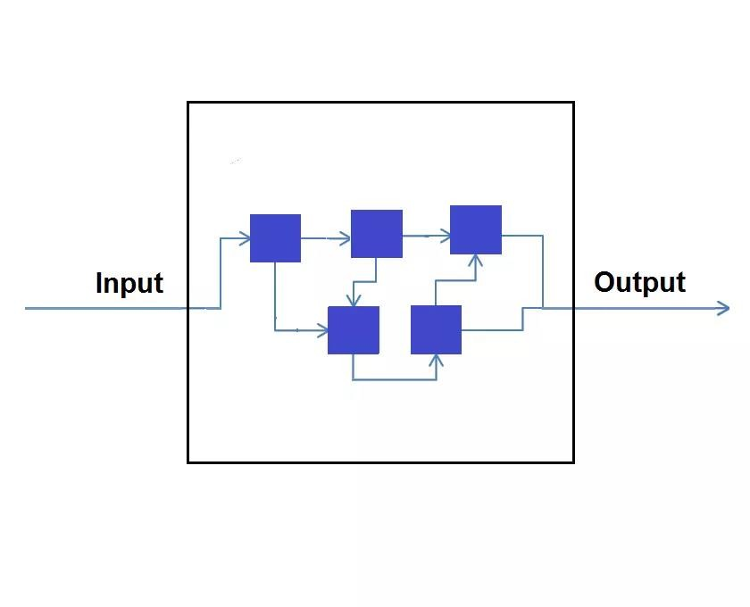
4-White-Box Testing:
-Testing while monitoring the internal structure of the system

Slide 36
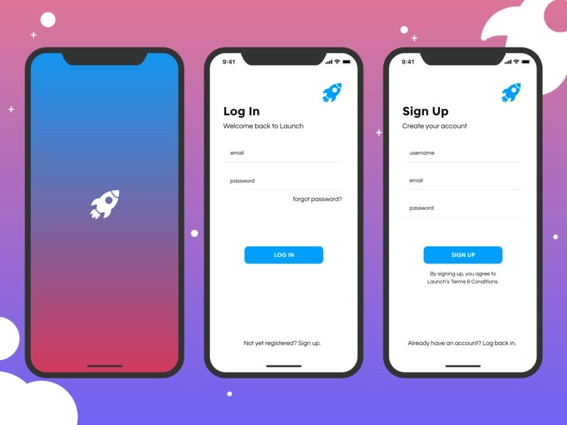
5-Dynamic Testing
-Testing that includes executing the software

Slide 37
6-Static Testing
-Testing that doesn’t includes executing the software

Slide 38

7-Retesting (Confirmation Testing)
Testing after debugging to ensure defects are fixed

Slide 39

8-Regression Testing
Testing unchanged areas to ensure they are not affected by changes

Slide 40
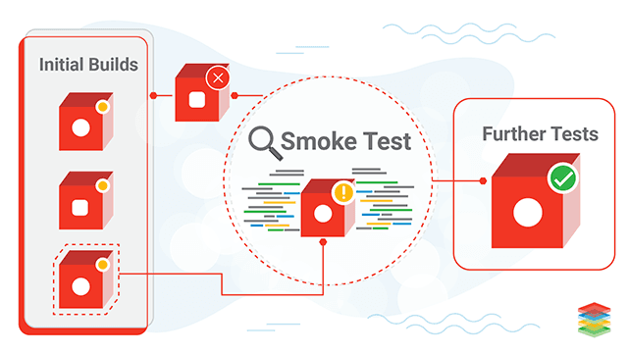
9-Smoke Testing
Testing main functionalities to ensure that the build is stable enough to continue testing

Slide 41
Test Case Writing

Slide 42
What is a test case?
A set of preconditions, inputs, actions (where applicable), expected results and postconditions, developed based on test conditions.

Slide 43
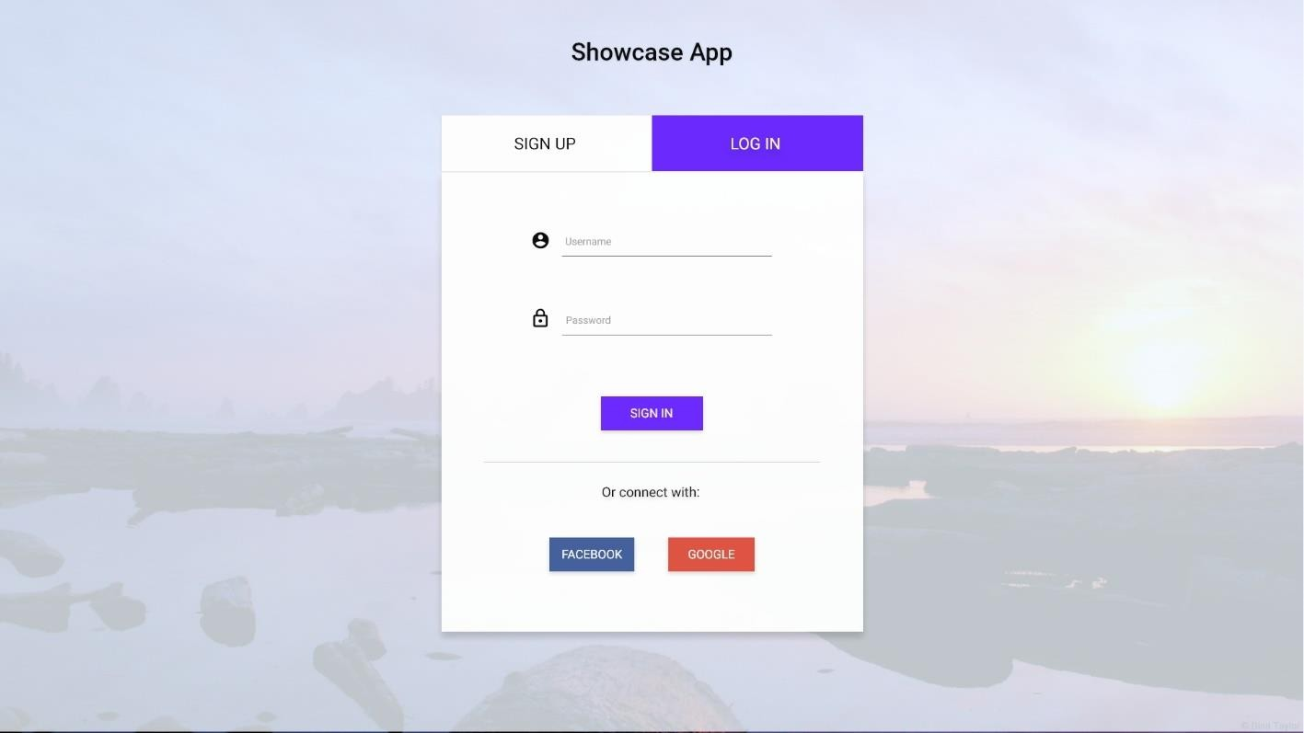
1-Test Case Title:
Verify login with a valid username & password

Slide 44
2-Precondition:
User is already registered using valid credentials

Slide 45
3-Test Steps
Enter a valid username
Enter a valid password
Click on sign in

Slide 46
4-Expected result:
User is logged in successfully and redirected to (XYZ) page

Slide 47
5-Test Scenario (Test Suite)
Login

Slide 48
6-Test Environment
Windows 10 – Chrome – Wi-Fi
Samsung Galaxy Note 10 - Android 10 – 4G Network
iPhone 11 – iOS 13.3.1 – 5G Network

Slide 49
7-Actual Result:
Very important note: Never fill the actual result field until you execute the test case

Slide 50
8-Status
New (Ready to test) | The test case is not executed
Pass | The test case is executed and the actual result is the same as the expected result
Fail | The test case is executed and the actual result is different from the expected result
Blocked/Skipped | The test case can’t be executed

Slide 51
Example Test Case
Title | Login with a valid username & password
Precondition | User is already registered using valid credentials
Test Steps | Enter a valid username Enter a valid password Click on sign in
Expected Result | -User is logged in successfully -User is redirected to Home page
Test Suite | Login
Test Environment | Samsung Galaxy Note 10 - Android 10 – 4G Network
Actual Result | Same as expected
Status | Pass

Slide 52
Bug Report Writing

Slide 53

What is a defect report?
Documentation of the occurrence, nature, and status of a defect.

Slide 54
What is a defect?
An imperfection or deficiency in a work product where it does not meet its requirements or specifications. [Synonyms: bug, fault]

Slide 55
1-Bug Report Title:
Section -> Description
Register -> No error message appears when user leaves password field empty

Slide 56
2-Steps to reproduce:
Must be very specific
Ex:
  Open www.facebook.com
  Click on the hamburger icon in the upper left corner
  Scroll down to the bottom of the screen
  Click on Settings
  Click on data usage
  Change data usage to “minimum limit”

Slide 57
3-Expected Result:
The same expected result like in the test case

Slide 58
4-Actual Result:
What really happened when the steps are executed

Slide 59
5-Test Environment
Specify the environment(s) in which the defect occurred
  Windows 10 – Chrome – Wi-Fi
  Samsung Galaxy Note 10 - Android 10 – 4G Network
  iPhone 11 – iOS 13.3.1 – 5G Network

Slide 60
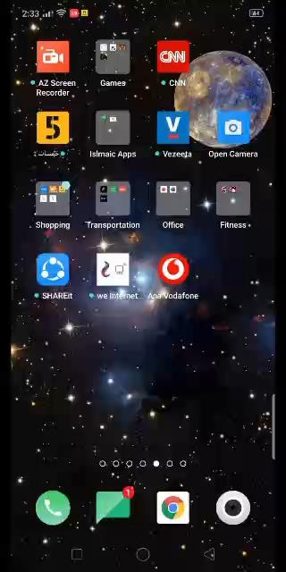
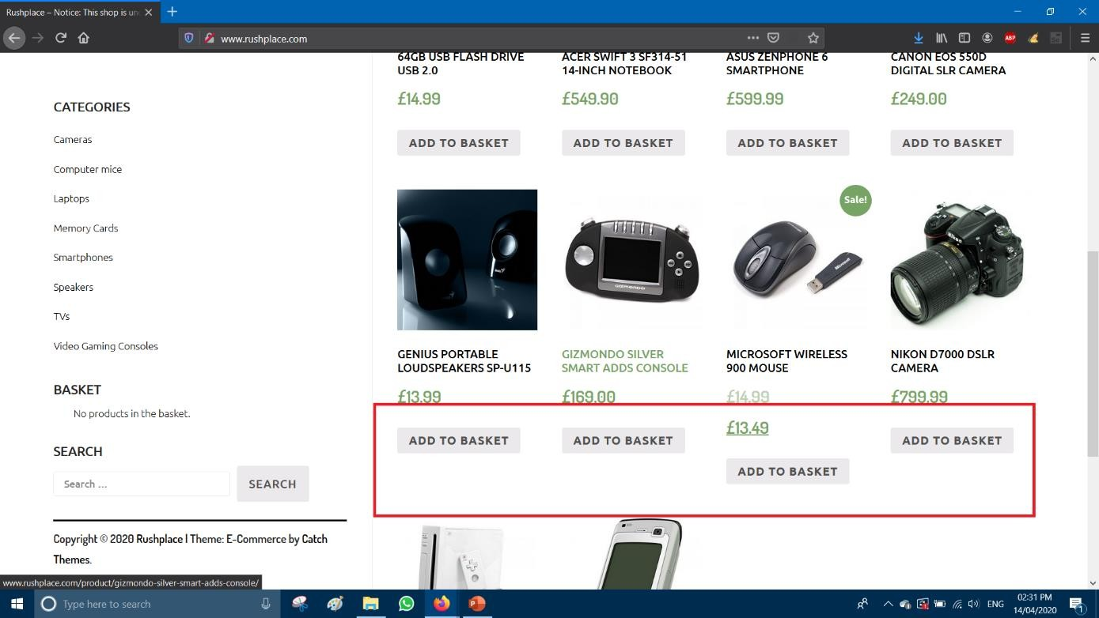
6-Screenshot or video:
The screenshot must show the whole screen
A red rectangle should be around the defect area
The video should show the clicks on the keyboard

Slide 61
7-Bug priority:
Critical: Login isn’t working-Application crashes in Home page – Wrong cart value
High: Login page responds slowly – User is not able to add profile image
Medium: Some pages have poor performance- Portrait mode isn’t working correctly
Low: Spelling mistakes – Image misalignment

Slide 62
Defects’ Types

Slide 63
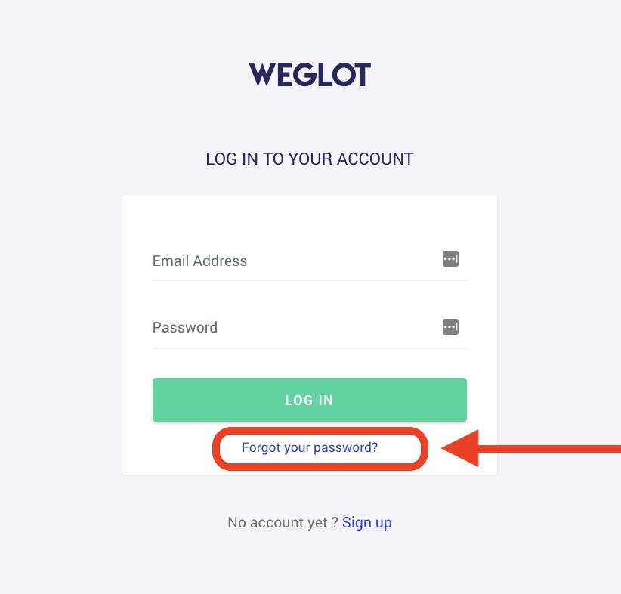
1-Functional:
Forgot password functionality isn’t working

Slide 64
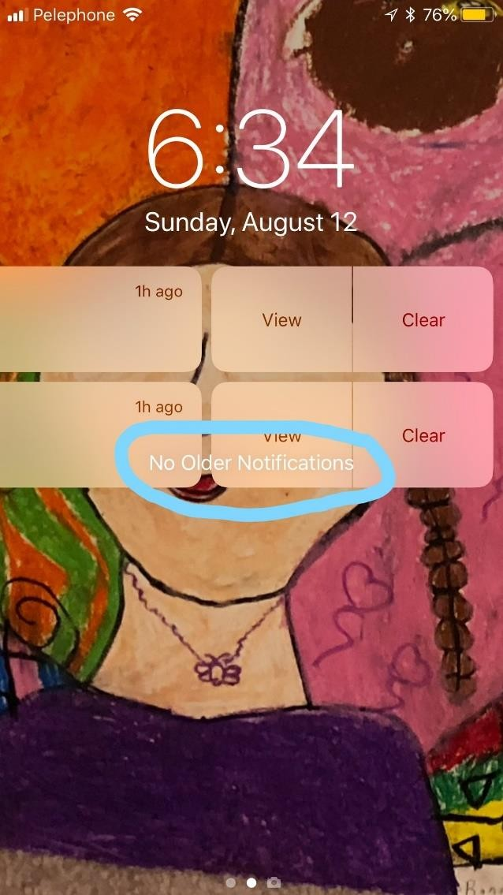
2-Visual (UI):

Slide 65
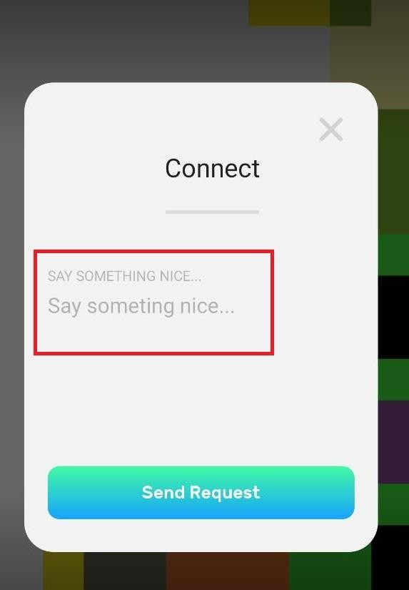
3-Content:

Slide 66

4-Performance:
Videos take too much time to play

Slide 67

5-Suggestion:
The font of the placeholder should be bigger

Slide 68
8-Status
New (Ready to test) | The test case is not executed
Pass | The test case is executed and the actual result is the same as the expected result
Fail | The test case is executed and the actual result is different from the expected result
Blocked/Skipped | The test case can’t be executed

Slide 69
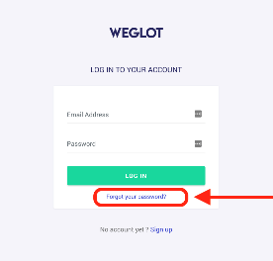
Example Defect Report
Title | Login -> Forgot password button isn’t working
Steps to reproduce | Click on Login Click on Forgot password
Expected Result | The button can be clicked and user should be redirected to a page to enter his email
Actual result | Clicking on the button doesn’t have any impact
Test Environment | Samsung Galaxy Note 10 - Android 10 – 4G Network
Priority | High
Type | Functional
Screenshot

